Slide 1
WEB Technologies (CS-566)
LECTURE # 8– Tables in HTML

Slide 2
Outline
How to create tables in HTML
Table Attributes

Slide 3
HTML Tables

Slide 4
Creating HTML tables
A table in HTML consists of table cells inside rows and columns. There can be many columns in a row and many rows in a table.
We can create a table to display data in tabular form, using <table> element, with the help of <tr> table row , <td> table data, and <th> table head elements.
<tr> tag is used to defined the rows of table.
The contents of the cell are written between <td> and </td> tags. A table cell can contain all sorts of HTML elements: text, images, lists, links, other tables etc.
<th> tag is used to declare the cell of the heading row of the table.

Slide 5
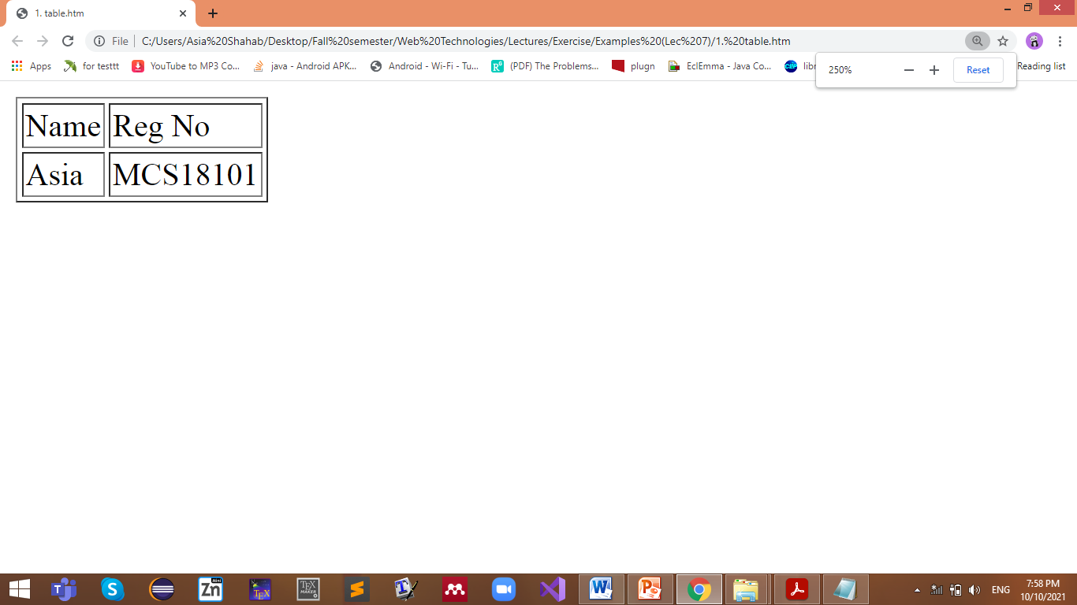
Example
<html>
<body>
<table border=“1”>
<tr>
<td> Name </td>
<td> Reg No </td>
</tr>
<tr>
<td>Asia</td>
<td>MCS18101</td>
</tr>
</table>
</body>
</html>

Slide 6
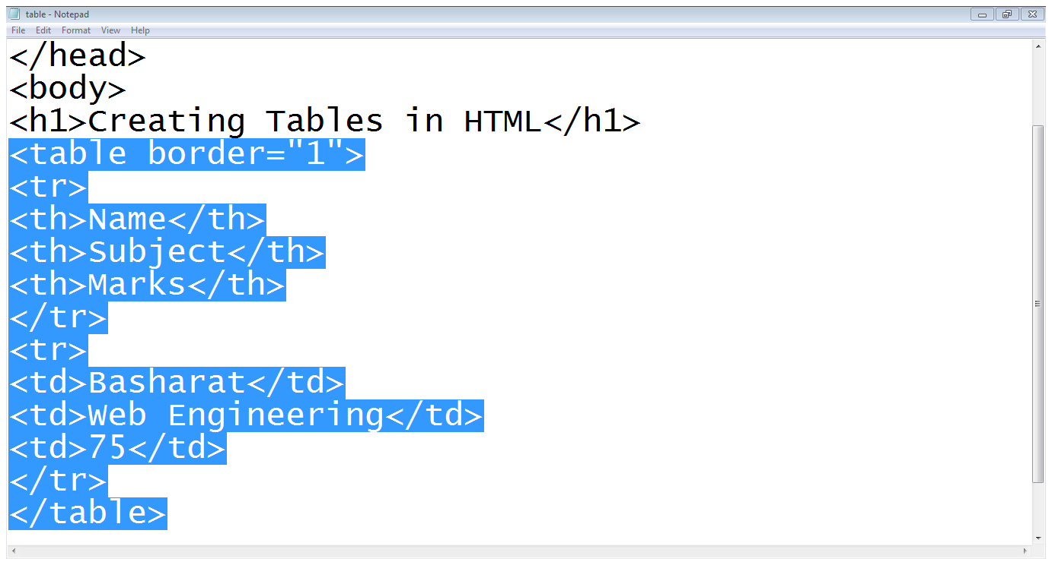
Example

Slide 7
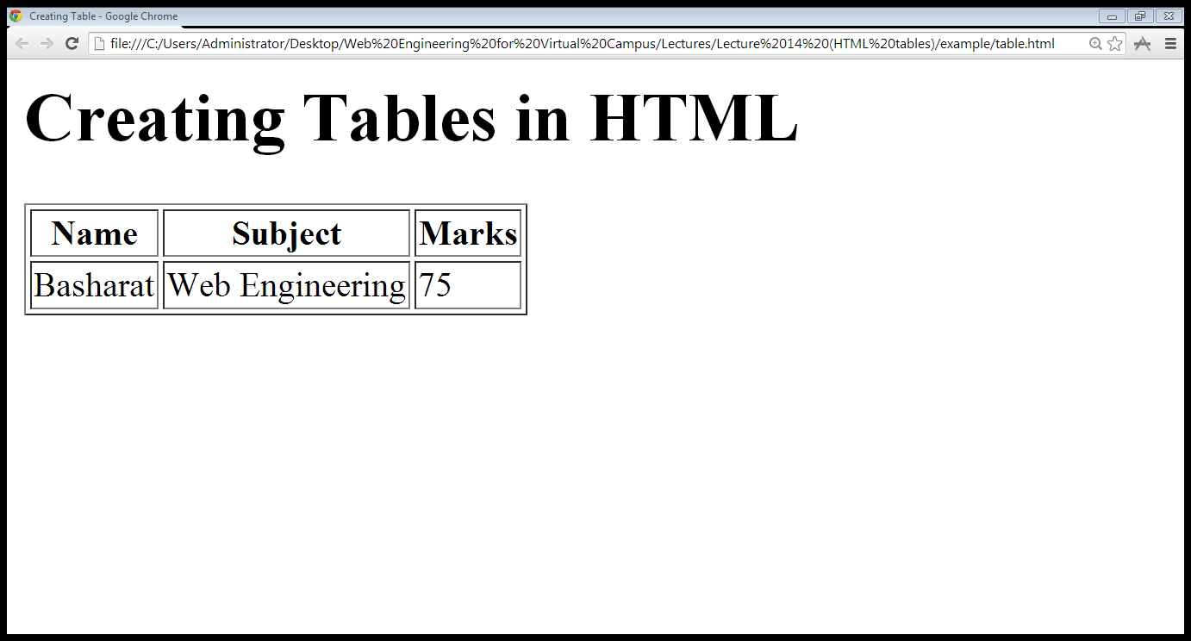
Output

Slide 8
Table Attributes

Slide 9
Table Attributes
Table level attributes
Row level attributes
Cell level attributes

Slide 10
Table level attributes

Slide 11
Table Attribute
The border Attribute: Indicates presence of the border around the table
<table border=“1”>
The align Attribute:
<table align= “center, right or left”>
The bgcolor Attribute: sets the background color of the table
<table bgcolor=“pink”>
The bordercolor Attribute: sets the color of borders table.
<table bordercolor=“green”>
The background Attribute: sets the specified image at the background of the table
<table background=“image-title”>

Slide 12
Cont…
The height and width Attributes: To set the width of a table, add the style attribute to the <table> element.
<table width=“100%” height=“100%”>
The cellpadding Attribute: The cell padding attribute is used to create a gap between the edges of a cell and its contents.
<table cellpadding=“50”>
The cellspacing Attribute: The cellspacing attribute is used to create a space between the borders of each cell.
<table cellspacing=“10”>

Slide 13
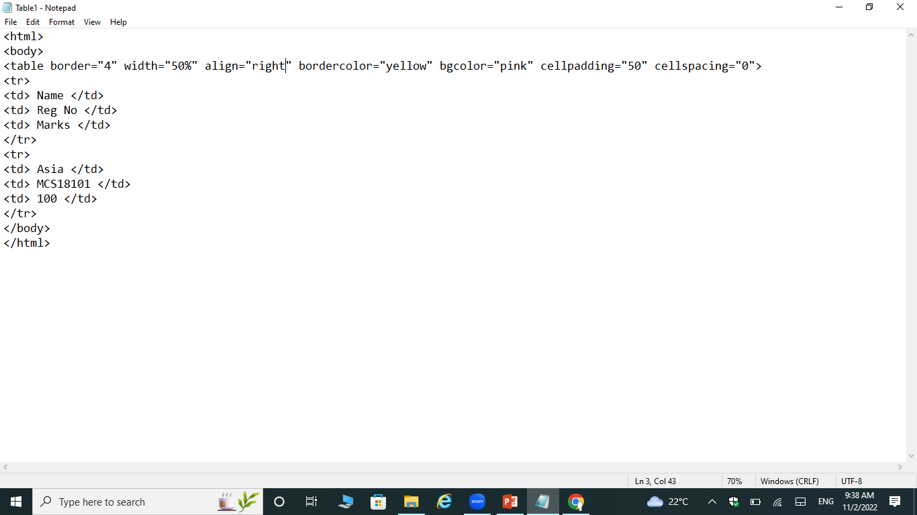
Example

Slide 14
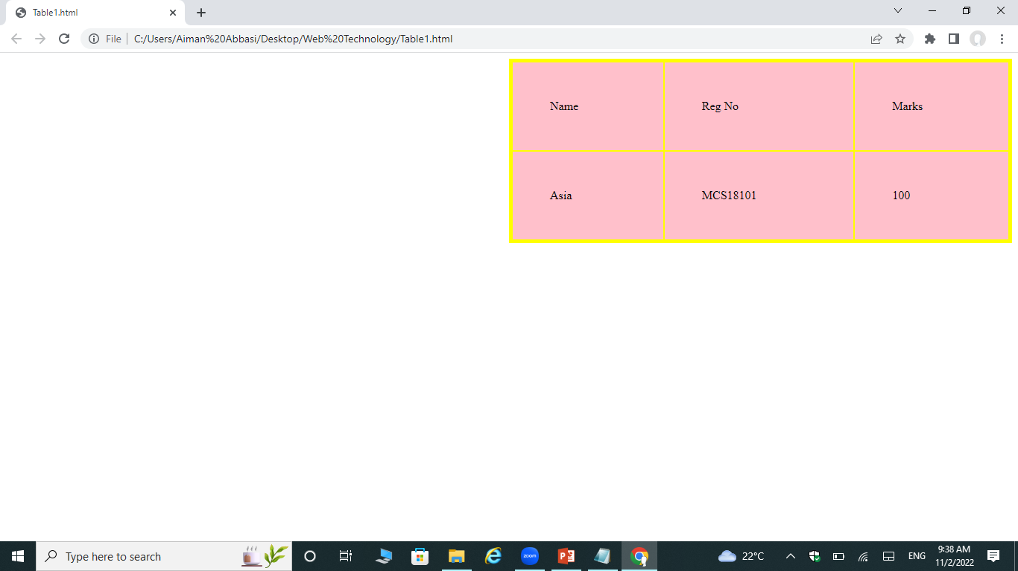
Output

Slide 15
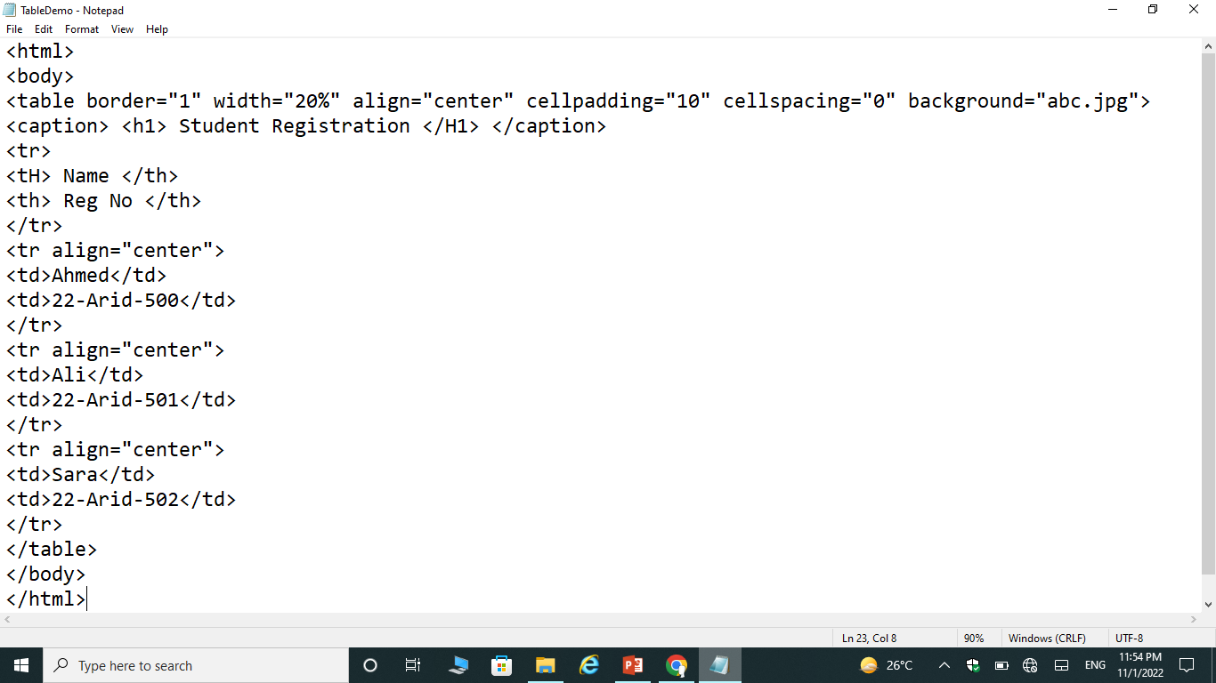
Example

Slide 16
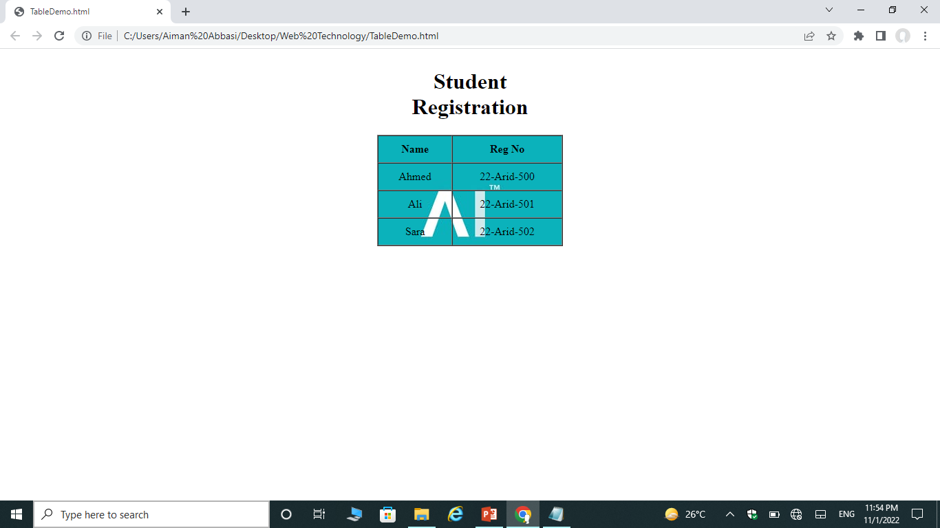
Output

Slide 17
Row level attributes

Slide 18
Row level attributes
The align Attribute:
<tr align=“center, right or left”>
The bgcolor Attribute:
<tr bgcolor=“gray”>
The background Attribute:
<tr background=“image-name”>
The height and width Attributes:
<tr height=“20” width=“20”>
The valign Attributes: vertical align
<tr valign=“top, middle or bottom”>

Slide 19
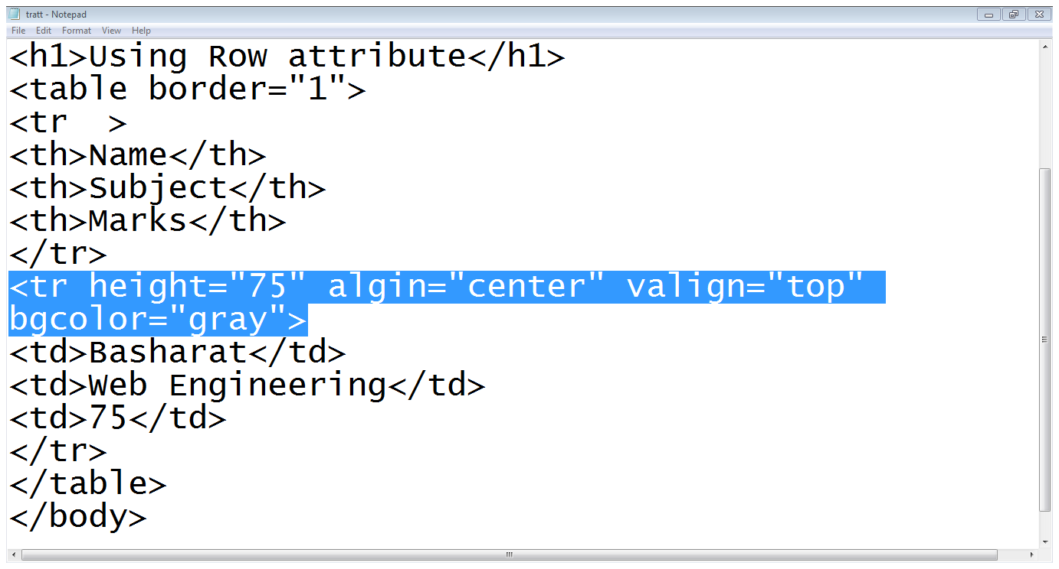
Example

Slide 20
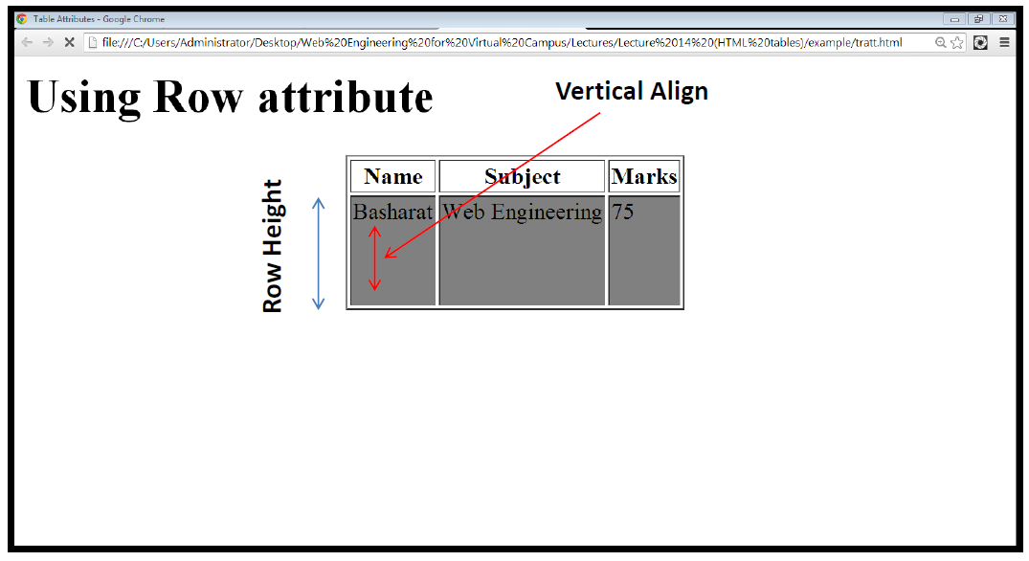
Output

Slide 21
Cell level attributes

Slide 22
Cell level attributes
The align Attribute:
<td align=“center, right or left”>
The bgcolor Attribute
<td bgcolor=“gray”>
The valign Attributes: vertical align
<td valign=“top, bottom, middle”>
The background Attribute
<td background=“image-name”>
The rowspan Attributes: used when a cell should span across more than one rows.
The colspan Attribute: used when a cell should span across more than one column.

Slide 23

Example
<table border="1">
<tr>
<th>Name</th>
<td>Jill</td>
</tr>
<tr>
<th rowspan="2">Phone</th>
<td>555-1234</td>
</tr>
<tr>
<td>555-8745</td>
</tr>
</table>

Slide 24

example
<table border="1">
<tr>
<th colspan="2">Name</th>
<th>Age</th>
</tr>
<tr>
<td>Jill</td>
<td>Smith</td>
<td>43</td>
</tr>
<tr>
<td>Eve</td>
<td>Jackson</td>
<td>57</td>
</tr>
</table>

Slide 25
Styling specific columns of the table

Slide 26
Styling specific columns of the table
<colgroup> tag is used to style specific columns of a table.
Each group is specified with a <col> tag.
Attributes:
Span: Specifies how many columns that get the style.
Style: Specifies the style to give the columns.
The <colgroup> tag must be a child of a <table> element and should be placed before any other table elements, like <thead>, <tr>, <td> etc., but after the <caption> element, if present.

Slide 27
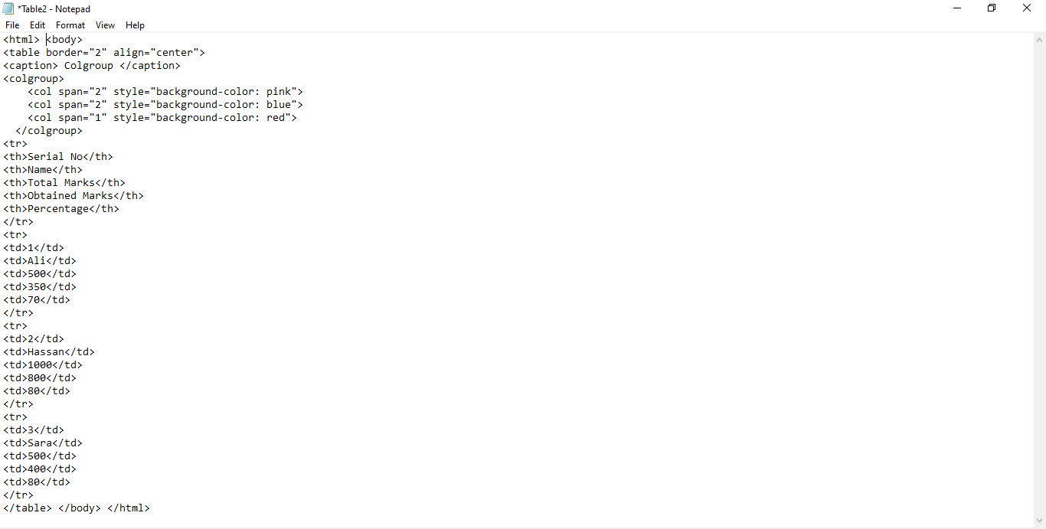
Example

Slide 28
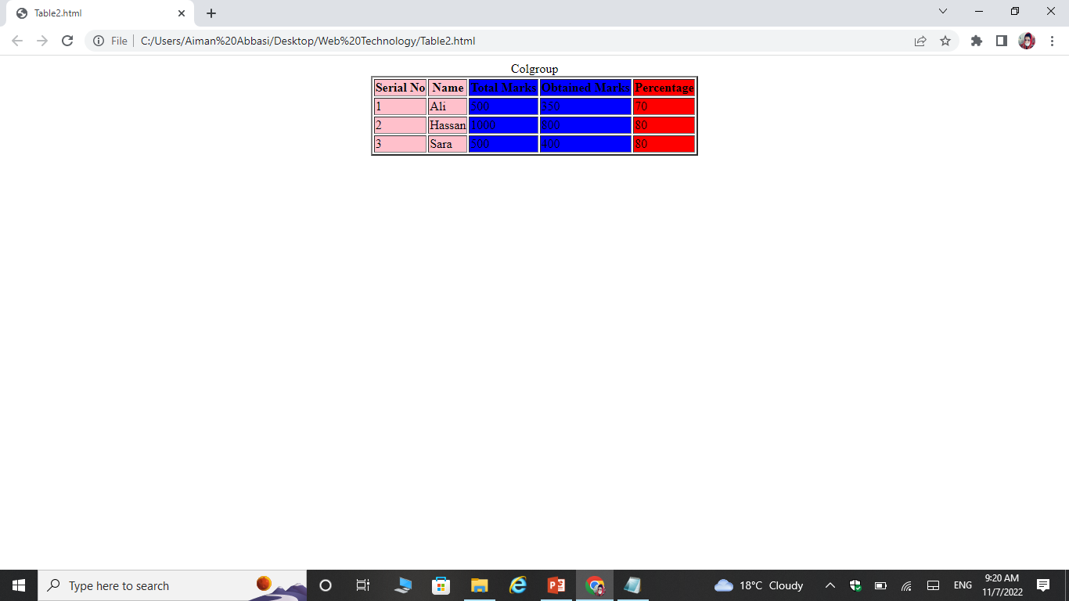
Output

Slide 29

Example

Slide 30
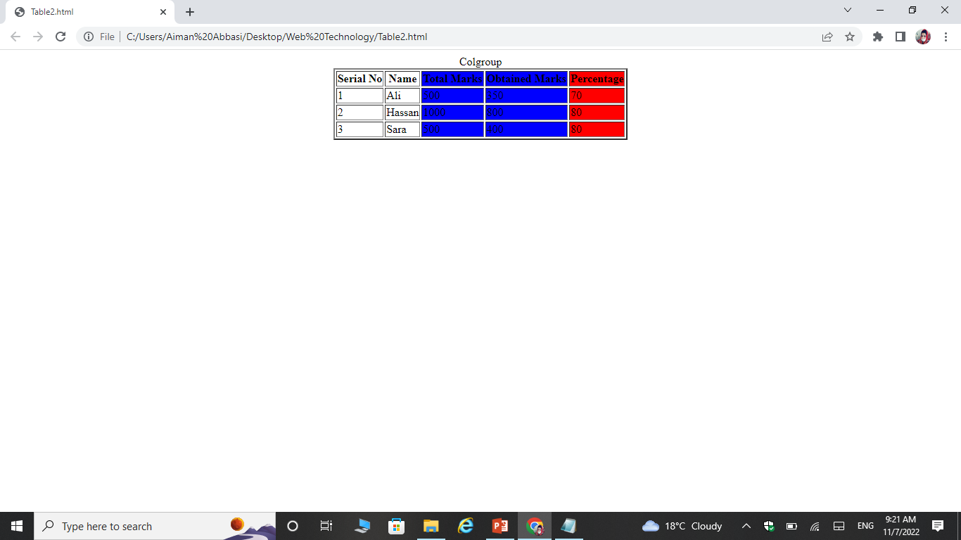
Output

Slide 31
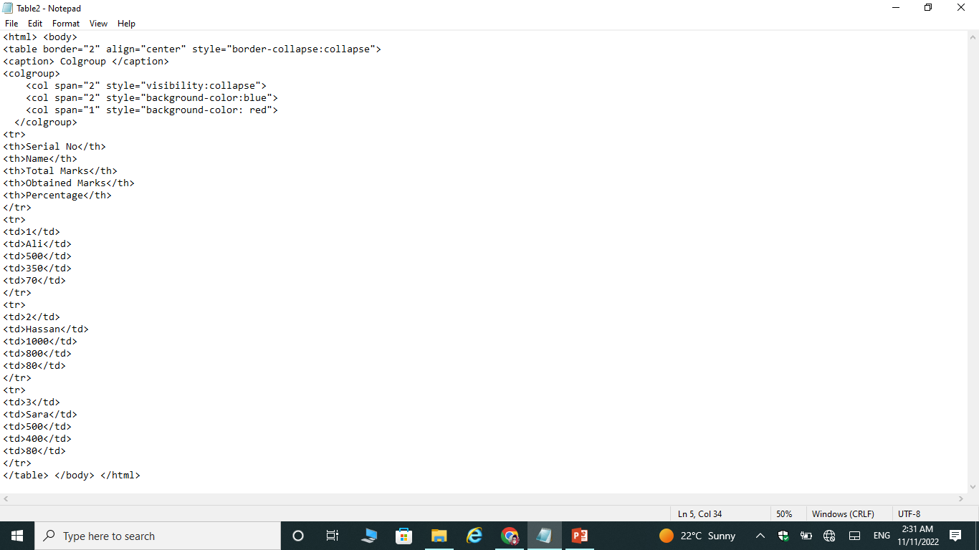
example

Slide 32
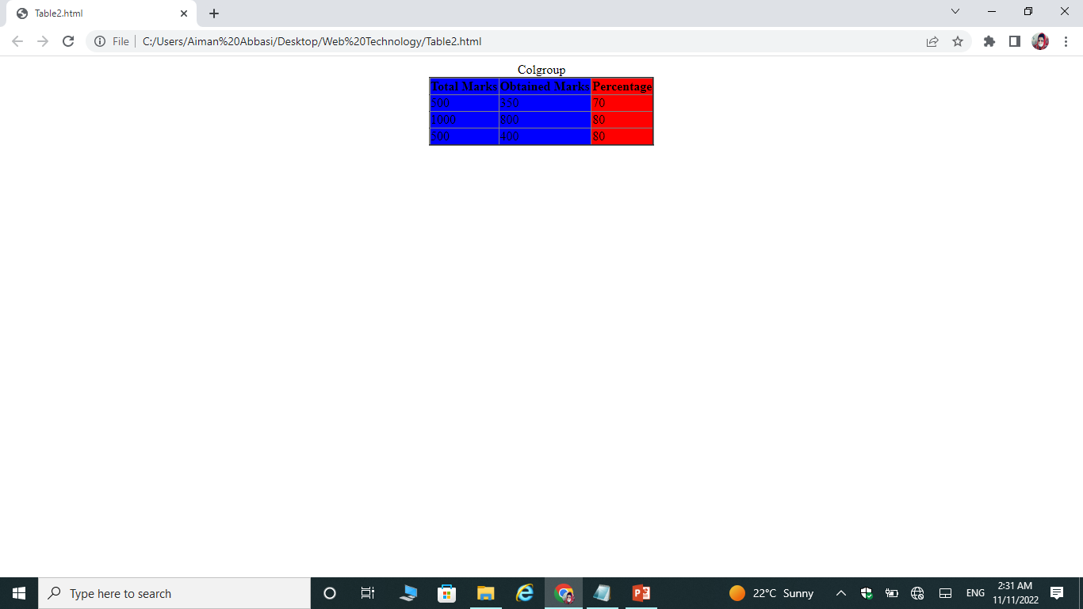
Output

Slide 33
Adding caption to the table

Slide 34
Adding caption to the table
<caption> tag is used to add a caption of the table
We usually add caption before the first row of the table

Slide 35
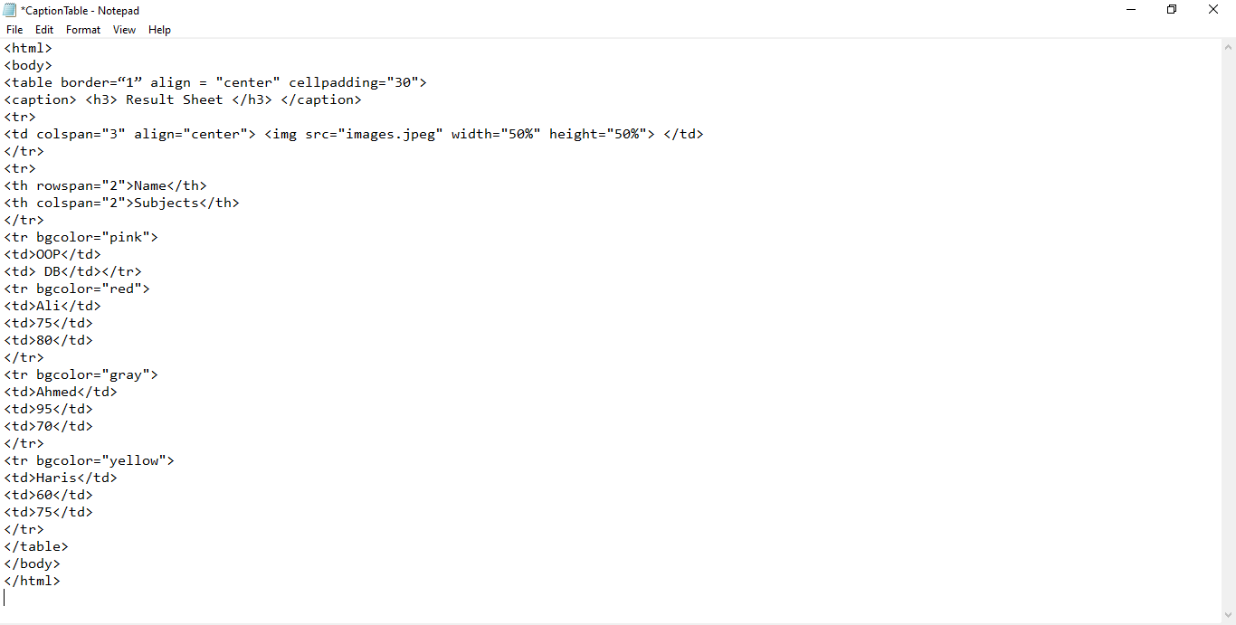
Example

Slide 36
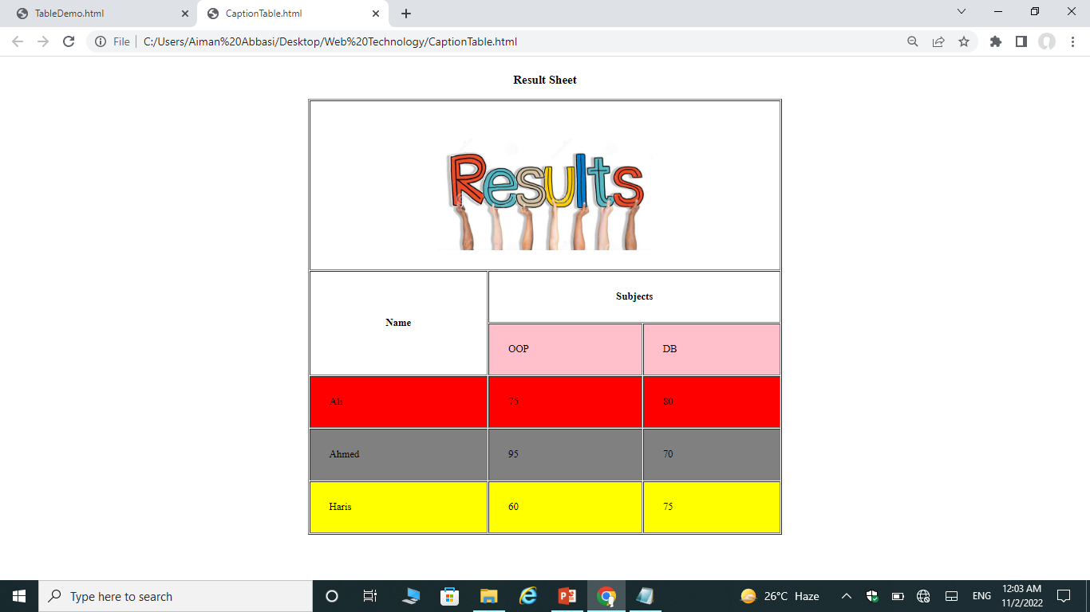
Output

Slide 37
Nested table in html

Slide 38
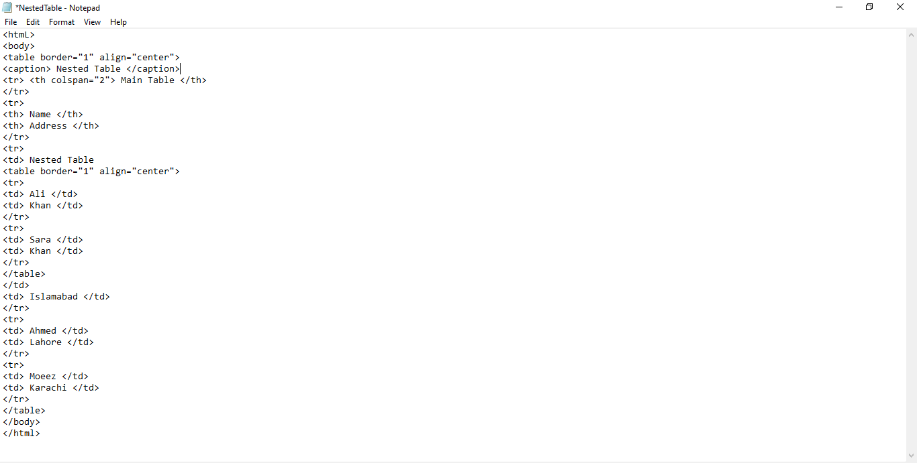
Example

Slide 39
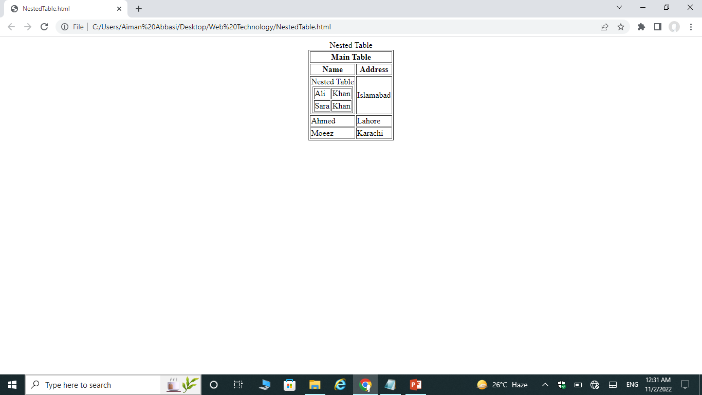
Output

Slide 40
Table head, Foot, Body

Slide 41
Table head, Foot, Body
Tables can be divided into three portions − a header, a body, and a foot.
The three elements for separating the head, body, and foot of a table are:-
<thead> − to create a separate table header.
<tbody> − to indicate the main body of the table.
<tfoot> − to create a separate table footer.

Slide 42
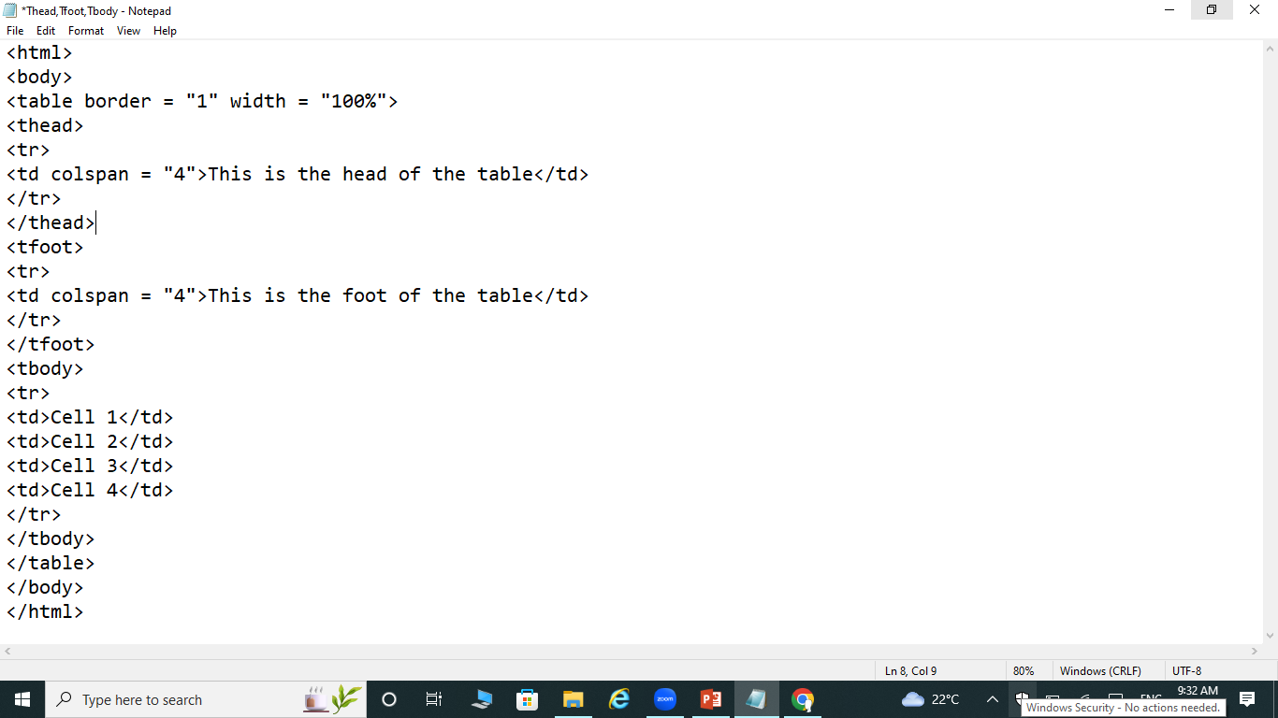
Example

Slide 43
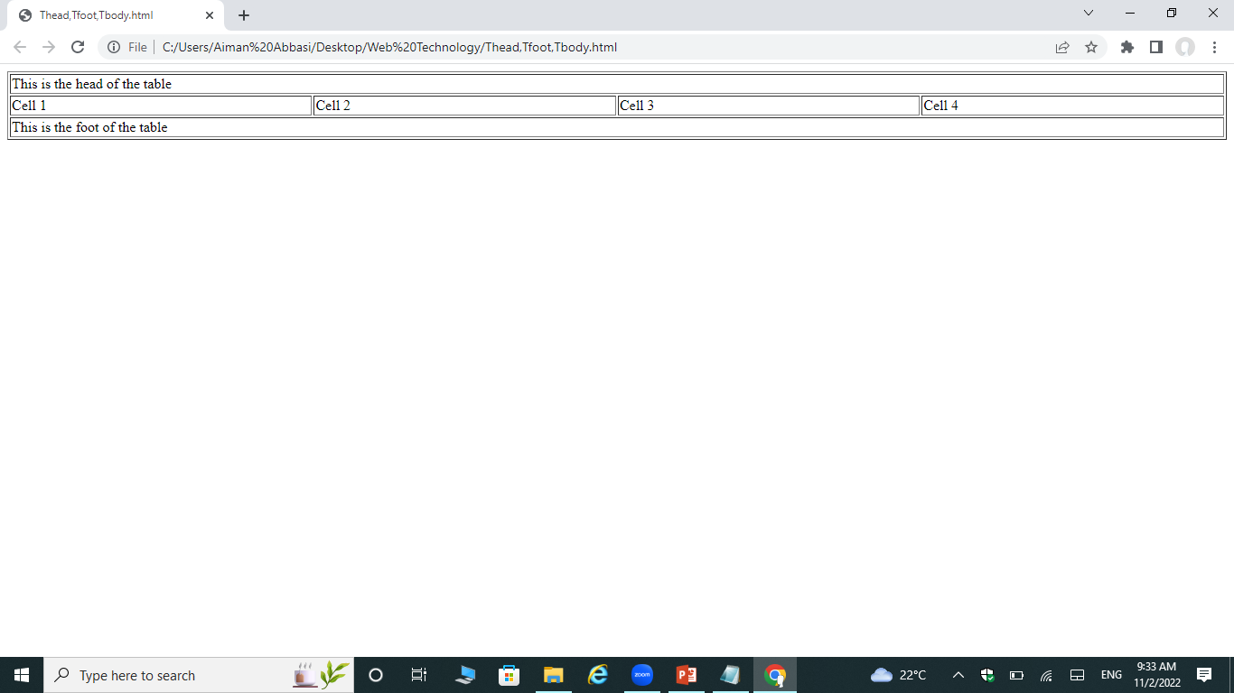
Output

Slide 44
Exercise question

Slide 45
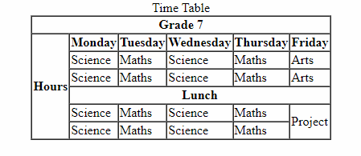
Exercise Questions
Create a Timetable given below.

